Slide 1
The SubFile Search
In this tutorial,
the following Topics are covered:
What is a Subfile?
How is a subfile defined?
LearN more about a subfile.
Why use a Subfile?
How to perform a Subfile search.

Slide 2
What is a Subfile?
The ICDD Subfile is a grouping of materials based on their chemistry or field of application.
Considerable editorial effort is involved in defining a Subfile. This effort is on-going and subfile definitions are ever-evolving.

Slide 3
How is a Subfile Defined?
Subfiles may be defined in any of the following ways:
Chemical formula
Metals & Alloys, some Explosives
Physical property characteristics
Ionic conductors, Ferroelectrics
Structural and/or crystallographic features
Perovskites, Polymers, Zeolites
By the material’s use
Bioceramics, Cement materials, Excipients

Slide 4
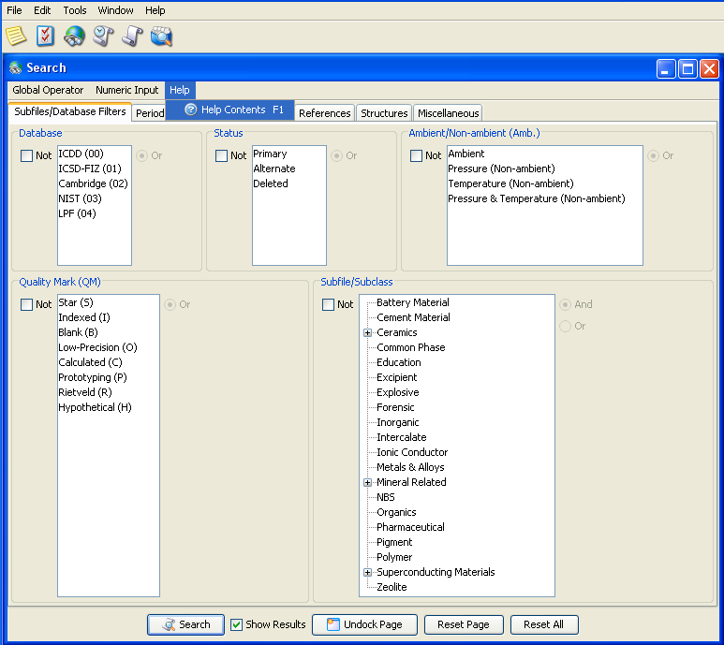
The Subfile Help Document:
More information about a subfile
may be found in the Help Contents
For more
information
about a specific Subfile, check the
Help Contents.
To open the
Help document click on the word Help or press the F1 key on your keyboard.

Slide 5
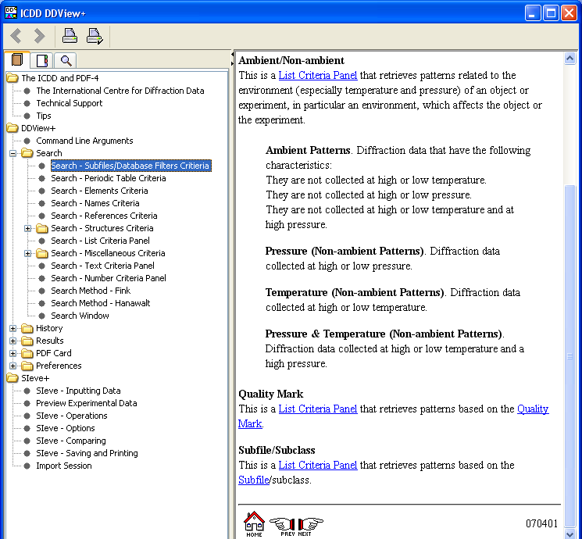
The Subfile Help document
Within the help
Document, open the Search folder.
Then click on
Subfiles/
Database
Filters Criteria
Scroll to the
Bottom of the
subfile page, click on the
Subfile link
indicated to the
right by the red
arrow.

Slide 6
Information about Subfiles Contained in the Help Document
Subfile Consultants:
Names of editors involved in creating the
subfile definitions.
Key References:
References used in creating the definition
Subfile History:
A brief history of the origin of the subfile.
Subfile Definition
May contain examples of what is and what is NOT included in the subfile.

Slide 7
Why Use a Subfile?
The Powder Diffraction File (PDF-4+) contains over 285,000 materials.
Subfiles speed your search by including only those materials you are interested in.

Slide 8
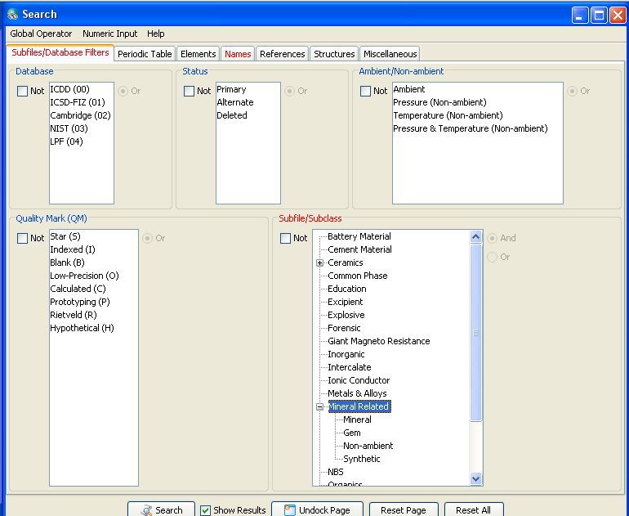
How to perform a Subfile Search
DETAILS:
This is the
SubFiles/
Database
Filters pane.
The
Subfile/
Subclass
panel is highlighted
The Subfile:
Mineral Related
has been chosen.
Notice the
Subclasses under the
Mineral Related
Subfile.

Slide 9
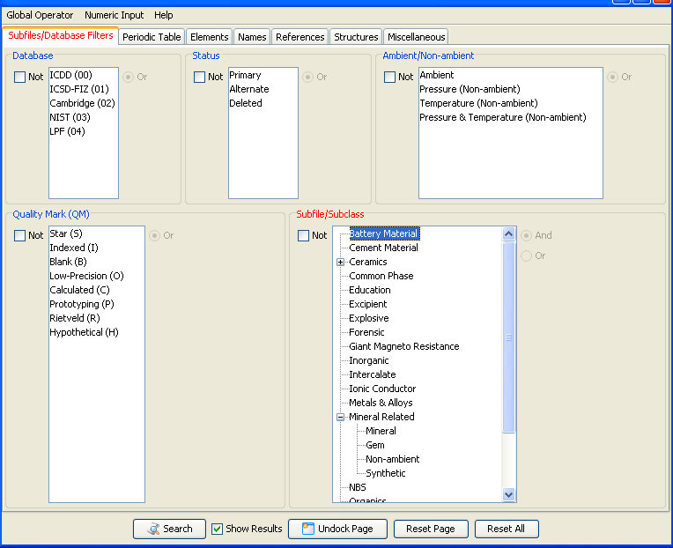
Let’s look at Battery Materials
Searching for
Battery materials
Is a general search and will return all
such materials.
However, if we are only interested in
batteries containing
Lithium, we may
further narrow
our search using the Periodic Table pane.
To reach the Periodic Table pane, click on
the tab indicated by the red arrow and labeled
Periodic Table

Slide 10
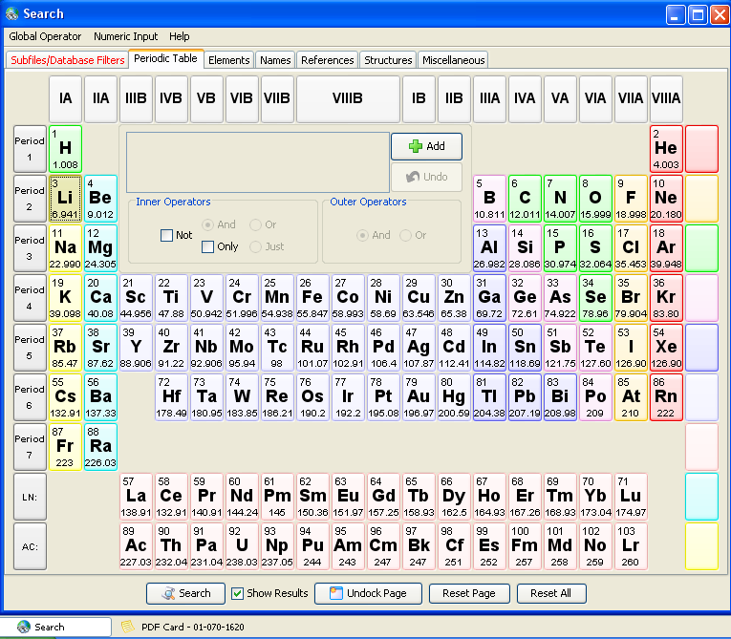
On the Periodic
Table pane, click on Li.
Then click on
the Add button
indicated by the red arrow.
This search is more specific and returns a subset of all the battery materials.

Slide 11
Conclusion
Subfiles are a convenient way to classify the enormous amount of data in the PDF.
Classifications are based on the chemistry, structure or application of the material.
If the user knows something about the chemistry of the compound to be analyzed, the search can be greatly facilitated by the use of the appropriate subfile.

Slide 12
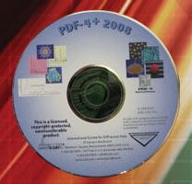
Thank you for viewing our tutorial. Additional tutorials are available at the ICDD web site (www.icdd.com).
International Centre for Diffraction Data
12 Campus Boulevard
Newtown Square, PA 19073
Phone: 610.325.9814
Fax: 610.325.9823

