Slide 1
SIeve+ Introduction
SIeve+ is a Plug-In module to the DDView+ software which is integrated in the PDF-4 products. SIeve+ is licensed separately at an additional cost, except for the PDF-4/Organics database. SIeve+ will activate for a free 30-day trial period or until the product is registered. A license for SIeve+ may be purchased along with a PDF-4 license or following the free 30-day trial period.
SIeve+ accepts the user data and searches the ICDD reference databases (PDF-4+, PDF-4/Organics, and PDF-4/Minerals) for comparison. There are several hundred thousand entries for both PDF-4+ and PDF-4/Organic databases. Therefore, various methods and criteria are used to ensure accurate efficient searches to obtained the accurate matches.
The matched results depend on the criteria and methods specified. This tutorial demonstrates the available methods and the operational procedure of SIeve+.

Slide 2
SIeve+ Purpose
SIeve+ will identify patterns of various X-ray powder diffraction (XRPD) data files:
Single phase XRPD patterns
Multi-phase XRPD patterns
Data file containing only XRPD peaks (*.xml)
Raw instrumental and/or converted data file formats:
CIF (*.cif)
X-Y (*.xrd)
GSAS (*.gsas, *.gss, *.gsa, *.raw, *.dat)
Bruker (*.uxd)
MDI (*.mdi)
PANalytical (*.xrdml, *.udf)
Scintag (*.ard)
Sietronics (*.cpi)
ICDD text (*.csv, *.prn, *.pd3)

Slide 3
SIeve+ Methods
There are different search methods and match criteria used to get accurate results. They include:
Hanawalt, with the option of 3 rotations. This uses the strongest line for the search. The rotation involves up to 3 strongest lines
Fink, with the option of 8 rotations. This uses the longest of the 8 strongest lines for the search. The rotation involves up to 8 strongest lines.
Search window and Match window are options for users to specify the error margin.
GOM, Pattern GOM, and Integral Index are quantities used to rank the matched reference patterns.

Slide 4
SIeve+ Search/Match Procedure
Input User Data
Specify Search/Match
Options (Preferences)
Specify Search/Match
Options (Preferences)
Reasonable New Match?
no
Accept Phase
Combine with DDView+ Search Criteria
no
yes
Single Phase?
Last Phase?
no
yes
yes
End

Slide 5
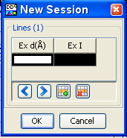
SIeve+ User Data Input
Frequently Used Icons
1 2 3 4 5 6 7 8 9 10 11 12 13
1. New Session: Manually input peaks
2. Open Session: Peak files
3. Import Session: Raw experimental digitized data files

Slide 6
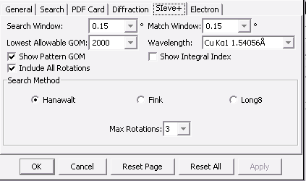
SIeve+ Miscellaneous Options
Frequently Used Icons
1 2 3 4 5 6 7 8 9 10 11 12 13
7. SIeve+ Preference:
Methods and Criteria window-
Search/Match error margin
Wavelength specification
GOM limit specification
Hanawalt/Fink with rotation
specification
12. Accept Phase
Comparison between the user data and reference data continues after “accepting” the current matched phase

Slide 7
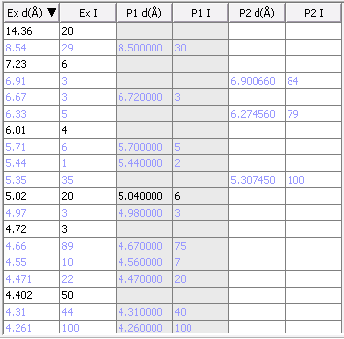
SIeve+ Phase Comparison Table
d-spacings/Intensities of Multi-phases and reference Patterns comparison table:
1st & 2nd columns:
Experimental data.
3rd & 4th columns:
First matched reference pattern data.
5th & 6th columns:
Second matched reference pattern data.

Slide 8
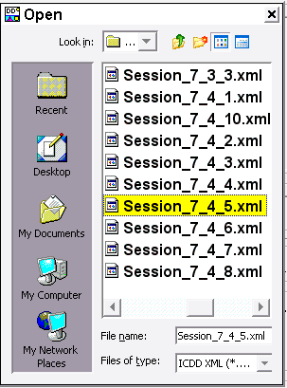
SIeve+ Example-1
Objective: Search for reference patterns in the PDF
database to match mixed phase peaks in a user file.
1. Click on the Open Session icon:
2. Select a peak file: Session_7_4_5.xml
3. Accept the phase “β – Lactose” with the highest GOM
4. 2nd matched phase “Ibuprofen” is found

Slide 9
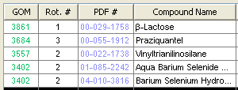
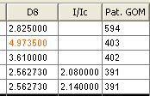
SIeve+ Example-1 Interpretation of matched results
Δ = window * d
tan(arcsin(λ / (2 * d) ))
Goodness of Match (GOM):
GOM = ( 1 - (line error / Δ) ) * ( 1 - (line error / Δ) ) * 1000
A Match - within the range of (experiment Spacing +- Δ)
Red: matched lines
Black: non-matched lines

Slide 10
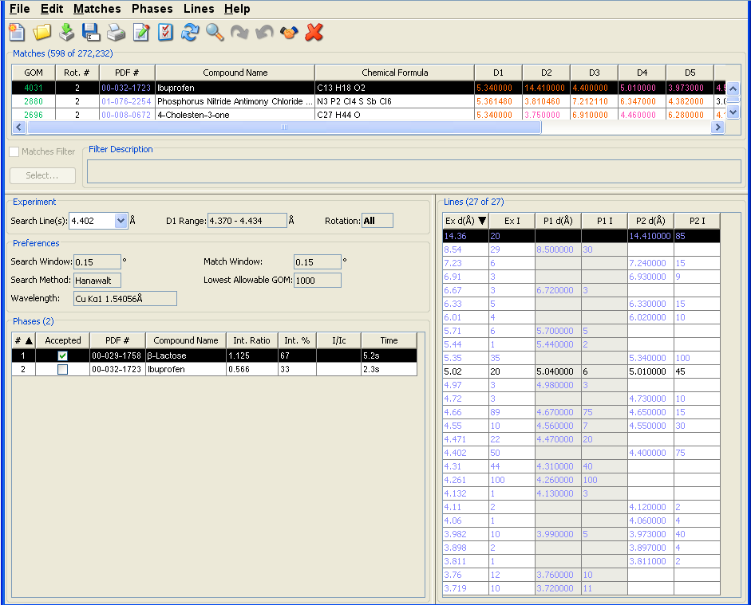
SIeve+ Example-1 Search/Compare Results Overview

Slide 11
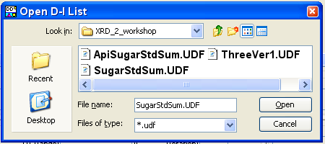
SIeve+ Example-2
Objective: Find matched patterns in the PDF database with the experimental raw data containing an active pharmaceutical ingredient, an excipient, and an internal standard.
1. Select Import Session Icon
2. Select a file containing raw data measured from an instrument
3. There are two options for importing the experimental file:
Advanced: User specifies the file format
Default: Software detects the file format
4. Data processing and peak finding
5. Search the database for matched reference patterns

Slide 12
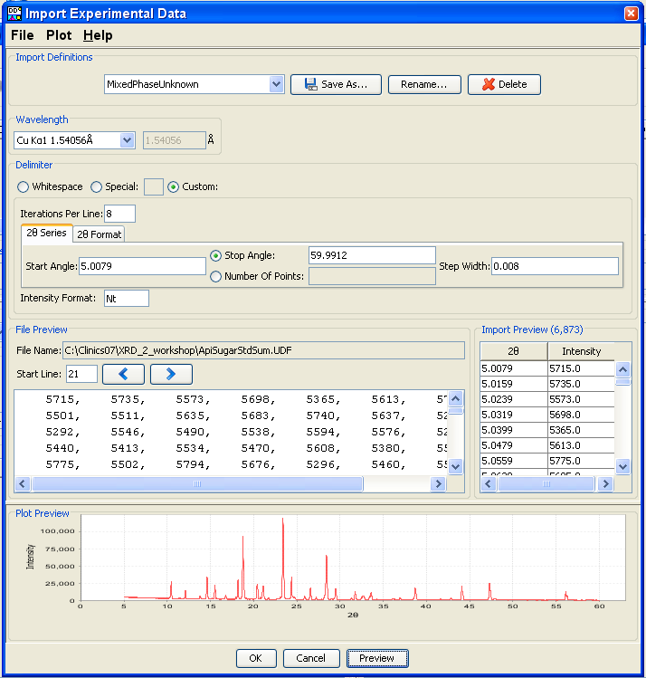
SIeve+ Example-2 Advanced Experimental Data Input
Advanced data input options:
Experimental Wavelength
2. Data points delimiters:
White spaces
Special characters
3. Customized format:
# of intensity points per line
Starting/stopping angles
Step width
Intensity format
4. Import format options
formatted data point preview
graphic plot preview

Slide 13
SIeve+ Example-2 Intensity Import Format
Input option notations:
c All characters should be skipped.
c[#] Skip specified numbers (#) of characters.
n All numbers should be skipped.
t All text should be skipped.
l Skip the rest of a line.
N All numbers should be imported.
N[#] Import fixed length data (# = fixed length)‏.

Slide 14
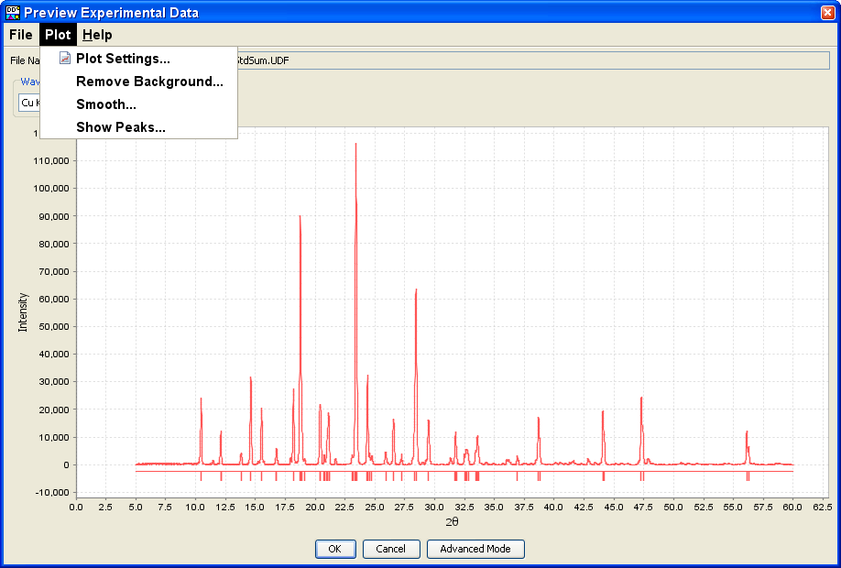
SIeve+ Example-2 Data Input Format Auto-Detect
The data is processed prior to searching the database.
Zero Correction
Intensity Scaling
Subtract Background
Profile Smoothing
Peak Finding

Slide 15
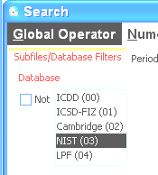
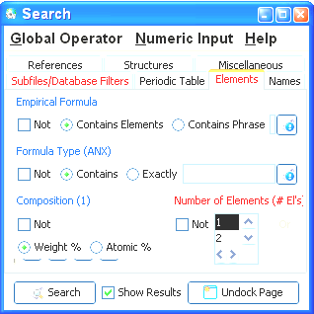
SIeve+ Example-2 Match Filter
Combine d-I search with other search criteria by
using the search options in the DDView+.
Include only NIST data.
Include compounds containing only one element.
Select the DDView+ search results by selecting the “Filter Description” from the SIeve+ window.

Slide 16
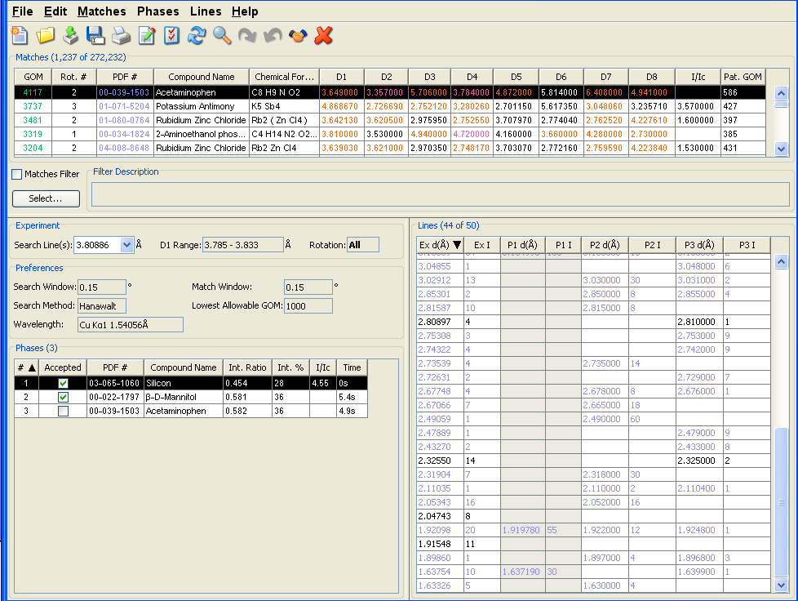
SIeve+ Example-2 Final Output
Filter was only used for the initial search. The filter was turned off after accepting the first and second phases.

Slide 17
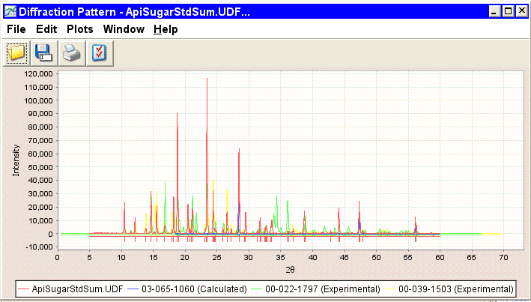
SIeve+ Example-2 Graphics Comparison
03-065-1060 Silicon, 00-022-1797 β-D-Mannitol, 00-039-1503 Acetaminophen

Slide 18
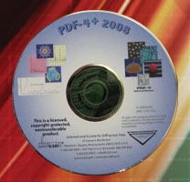
Thank you for viewing our tutorial. Additional tutorials are available at the ICDD web site (www.icdd.com).
International Centre for Diffraction Data
12 Campus Boulevard
Newtown Square, PA 19073
Phone: 610.325.9814
Fax: 610.325.9823

