Slide 1
Evaluating Data Quality

Slide 2
Quality Mark What is a Quality Mark?
A Quality Mark is a reliability index used in Powder Diffraction File (PDF).
Data validation and the assignment of the quality mark are the most important steps in the editorial process.
The Powder Diffraction File is the only crystallographic database that categorizes data based on its quality.

Slide 3
Quality Mark (QM) Types
Experimental patterns
Calculated patterns
The criteria for the assignment of the quality marks differ between patterns obtained experimentally and those determined from the crystal structure (calculated patterns).

Slide 4
QM for Experimental Patterns
Star (Well characterized chemically and crystallographically, no unindexed lines, ∆2ө≤0.03º)
R (d values obtained from Rietveld refinement)
I (Well characterized chemically, no unindexed strong lines, ∆2ө≤0.06º)
O (Poorly characterized, with editorial comment explaining the reason)
B (Does not meet the criteria for *, I, O)
C (Author calculated d values)
H (Hypothetical)

Slide 5
What are Calculated Patterns?
If we know the crystal structure, we can calculate the diffraction pattern using the following equation.
LP factor
Cell Volume
Multiplicity
Structure factor
Crystal structure
Displacement parameters

Slide 6
NOTE:
It is extremely important to make sure that the crystal structure used for the calculation is correct. In fact, this is the rate-determining step in the editorial process of calculated patterns.

Slide 7
QM for Calculated Patterns
The major step in this method involves several crystallographic and editorial checks by the ICDD, followed by the extraction and flagging of the structural database warnings/comments. Resulting calculated patterns will be classified into various categories based on the significance and nature of the warnings/comments. In the final step, a quality mark (QM) will be assigned to a calculated pattern based on its category.

Slide 8
Calculated Patterns QM Notations
Category | QM
No Warning | *
Minor Warning | I
Significant Warning | B
Assigned structure (Prototype) | P
Hypothetical | H
Major Warning | O

Slide 9
Quality Mark Why?
The Quality Mark plays an important role in interpreting search match results.
Editorial comments describing the quality of the pattern are extremely useful in evaluating and eventually accepting the search/match results.
For example, while using RIR in semi-quantitative analysis, editorial comments on incomplete or disordered structures are valuable.

Slide 10
Quality Mark How?
Quality mark search is under Subfiles/Database Filters tab.
Quality mark criteria can be used as a filter.
Multiple QMs can be chosen by clicking on the QM symbol while holding the Ctrl key.
Low quality patterns can be excluded by selecting the undesired QM with the Not box checked.

Slide 11
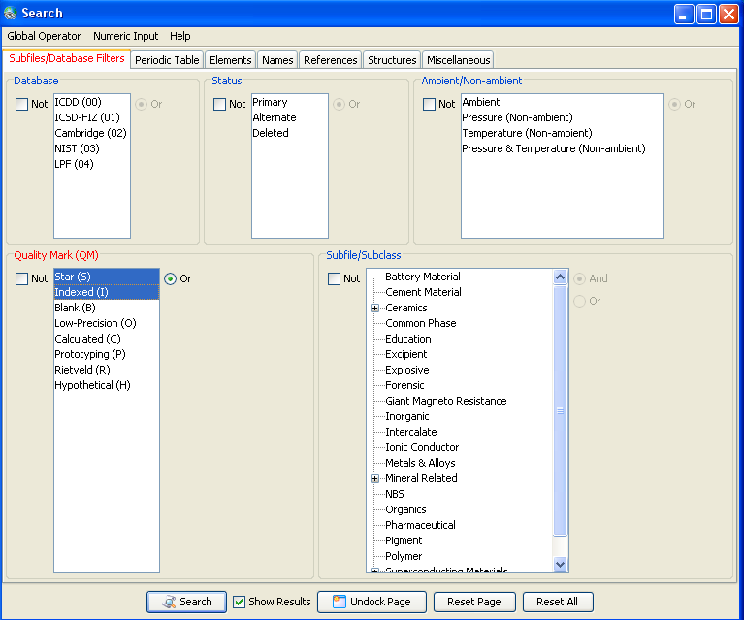
QM: Multiple Selection
In this example,
patterns with
either S or I
quality marks
will be returned
in the search results.

Slide 12
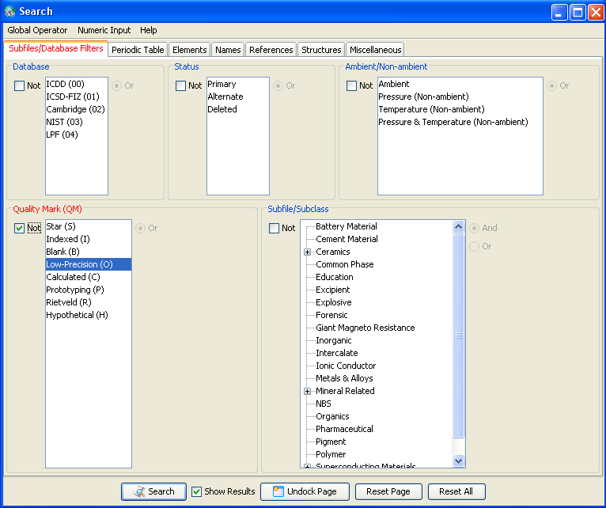
Excluding a Particular QM
To exclude a
particular QM,
be sure to check
the Not box.
Here, patterns with
O quality marks will
not be included in
the search results.

Slide 13
Quality Mark Example of Editorial Comments
Explanations of
a pattern’s quality
mark can be found
in the editorial
comments.
This Significant
Warning gives this calculated
pattern a quality mark of B.

Slide 14
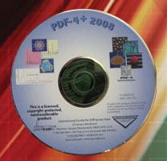
Thank you for viewing our tutorial. Additional tutorials are available at the ICDD web site (www.icdd.com).
International Centre for Diffraction Data
12 Campus Boulevard
Newtown Square, PA 19073
Phone: 610.325.9814
Fax: 610.325.9823

